Slide 1
Photography 101: Creating Better Images for Marketing, Publication and Web
Presented by: Ricardo Treviño Jr.,
Resident Director & University Photographer
@RicardoTrevinoJ
www.rtjphoto.com
#ACPA17

Slide 2
Land Acknowledgement
We would like to acknowledge that the land we are meeting on today has long served as a site of meeting and exchange amongst Indigenous peoples, specifically the Shawnee, Wyandotte, Miami and Delaware nations.
ACPA-College Student Educators International honors and respects the diverse Indigenous peoples connected to this territory on which we gather.
@RicardoTrevinoJ
www.rtjphoto.com
#ACPA17

Slide 3
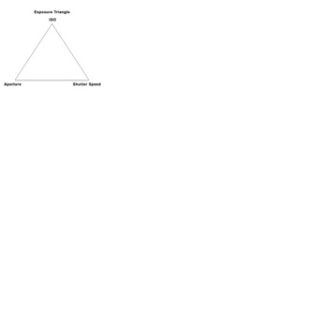
Understanding the Basics
Aperture, Shutter Speed, ISO
All of these control the amount of light picked up by the camera sensor.
All rely on each other and work in relation to one another.
All are represented in numerical values.
@RicardoTrevinoJ
www.rtjphoto.com
#ACPA17

Slide 4
Understanding the Basics
f/1.4 Small = Large Aperture
f/22 Larger = Small Aperture
Aperture, Shutter Speed, ISO
Represented as F-Stops.
f/2.8, f/4, f/5.6, f/8, etc.
Control Depth of Field (DoF) or apparent area in focus/focus range
Smaller f-number = More light/Shallower DoF
Larger f-number = Less light/more DoF
@RicardoTrevinoJ
www.rtjphoto.com
#ACPA17

Slide 5
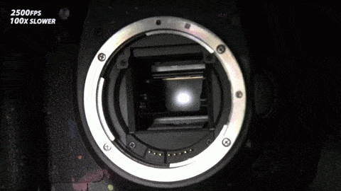
Understanding the Basics
Aperture, Shutter Speed, ISO
Represented in seconds.
1/60, 1/125, 1, 30, 1/1000, etc.
Amount of time light is allowed to the camera sensor.
Fast shutter speeds stop motion.
Slow shutter speeds blur motion.
@RicardoTrevinoJ
www.rtjphoto.com
#ACPA17

Slide 6
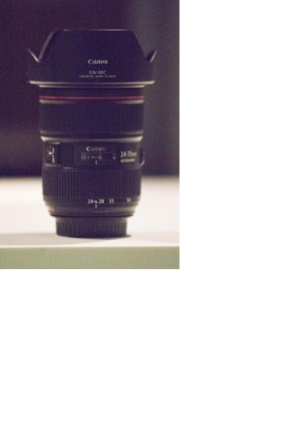
Understanding the Basics
Aperture, Shutter Speed, ISO
Represented as numerical values.
50, 100, 200, 400, 800, etc.
Controls how sensitive your camera senor is to light.
Low ISO’s are less sensitive to light and produce less noise.
High ISO’s are more sensitive to light and produce more noise.
@RicardoTrevinoJ
www.rtjphoto.com
#ACPA17
ISO 1600
ISO 51,200

Slide 7
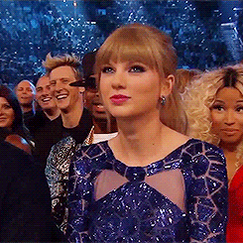
So far so good?
@RicardoTrevinoJ
www.rtjphoto.com
#ACPA17

Slide 8
Image Quality
Camera Sensor and Light
What makes up a good (high quality) image?
Your camera’s sensor makes a HUGE difference.
The amount of available light also makes a HUGE difference.
Other factors.
@RicardoTrevinoJ
www.rtjphoto.com
#ACPA17

Slide 9
Image Quality (cont.)
Camera Sensor and Light
Size matters!
Bigger sensors have bigger pixels and can gather more light.
This leads to a sharper image with less noise.
@RicardoTrevinoJ
www.rtjphoto.com
#ACPA17

Slide 10
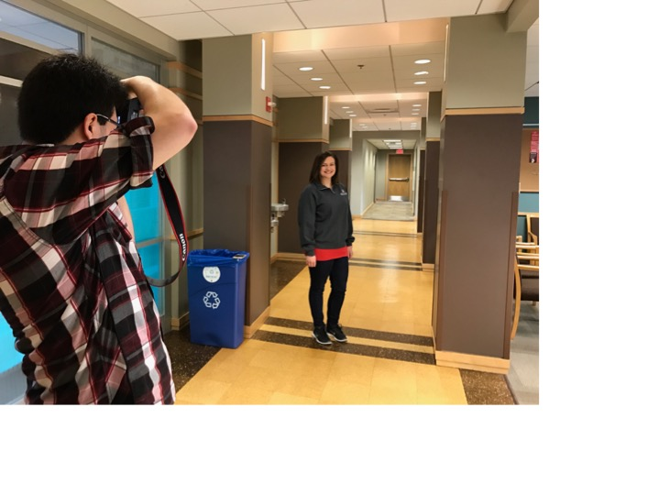
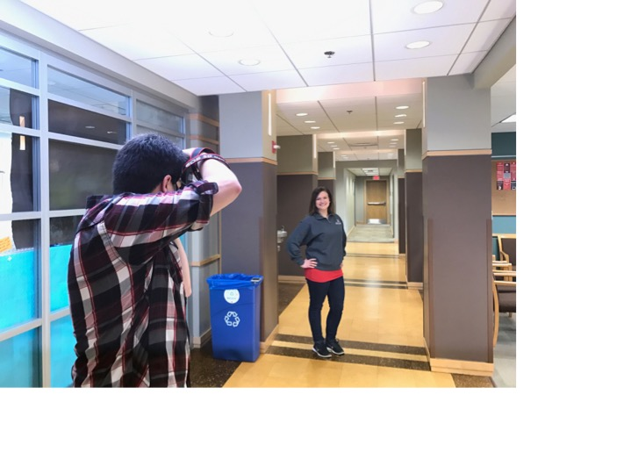
Image Quality (cont.)
Camera Sensor and Light
Camera sensors operate by gathering light to photosites (one per pixel).
The more light available, the better the sensor performs.
More light = sharper photo
Camera Phones are becoming gamechangers
@RicardoTrevinoJ
www.rtjphoto.com
#ACPA17

Slide 11
Still With Me?
@RicardoTrevinoJ
www.rtjphoto.com
#ACPA17

Slide 12
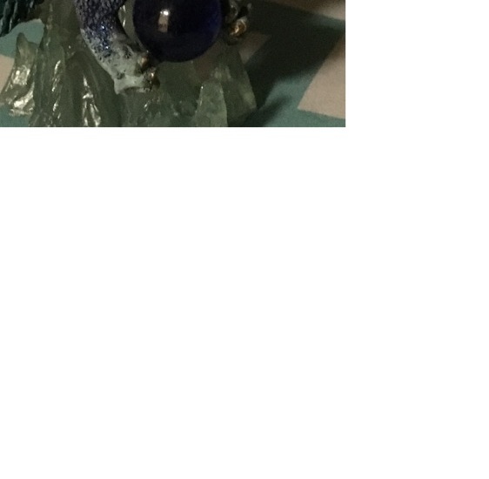
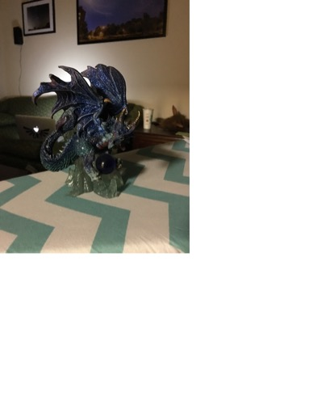
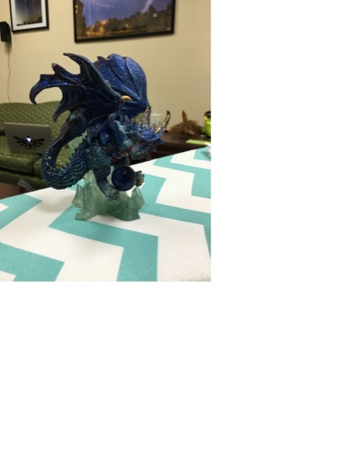
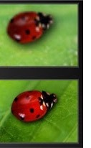
Making the Most of Your Phone
Tips for Getting Better Photos With Your Phone
Front Camera = ~8mp sensor Back Camera = ~12mp sensor
Zoom with your feet not with the lens*
More Light = Better Photo
@RicardoTrevinoJ
www.rtjphoto.com
#ACPA17

Slide 13
Making the Most of Your Phone (cont.)
Tips for Getting Better Photos With Your Phone
Composition
Rule of Thirds
@RicardoTrevinoJ
www.rtjphoto.com
#ACPA17

Slide 14
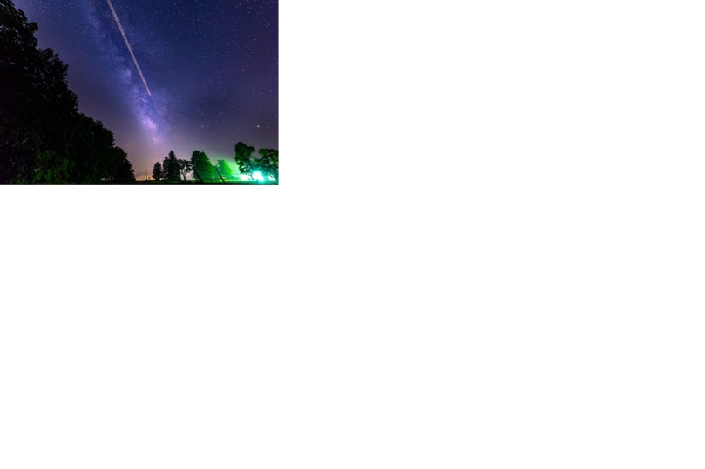
Making the Most of Your Phone (cont.)
Tips for Getting Better Photos With Your Phone
Composition
Rule of Thirds
Framing
Think about your subject
How does it interact with the scene?
@RicardoTrevinoJ
www.rtjphoto.com
#ACPA17

Slide 15
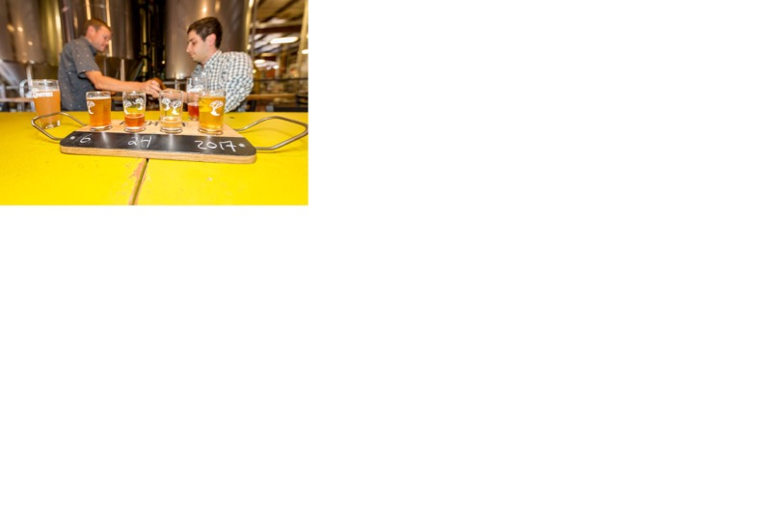
Making the Most of Your Phone (cont.)
Tips for Getting Better Photos With Your Phone
Composition
Rule of Thirds
Framing
Vantage Point
Low angle makes things look big
High angle makes “birds eye view”
@RicardoTrevinoJ
www.rtjphoto.com
#ACPA17

Slide 16
Making the Most of Your Phone (cont.)
Tips for Getting Better Photos With Your Phone
Composition
Rule of Thirds
Framing
Vantage Point
Lines
Lead you places
@RicardoTrevinoJ
www.rtjphoto.com
#ACPA17

Slide 17
Making the Most of Your Phone (cont.)
Tips for Getting Better Photos With Your Phone
Composition
Rule of Thirds
Framing
Vantage Point
Lines
Contrast
@RicardoTrevinoJ
www.rtjphoto.com
#ACPA17

Slide 18
Making the Most of Your Phone (cont.)
Tips for Getting Better Photos With Your Phone
Editing!
@RicardoTrevinoJ
www.rtjphoto.com
#ACPA17

Slide 19
Making the Most of Your Phone (cont.)
Tips for Getting Better Photos With Your Phone
Editing!
You can edit on your smartphone!
iPhone = Photos
Android = Photo Wizard
@RicardoTrevinoJ
www.rtjphoto.com
#ACPA17

Slide 20
Editing
Tips for Editing Images on Your Phone
Find the “Sliders”
@RicardoTrevinoJ
www.rtjphoto.com
#ACPA17

Slide 21
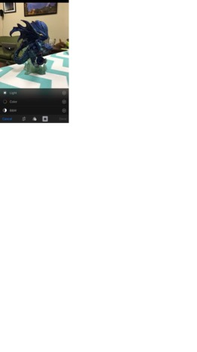
Editing (cont.)
Tips for Editing Images on Your Phone
@RicardoTrevinoJ
www.rtjphoto.com
#ACPA17

Slide 22
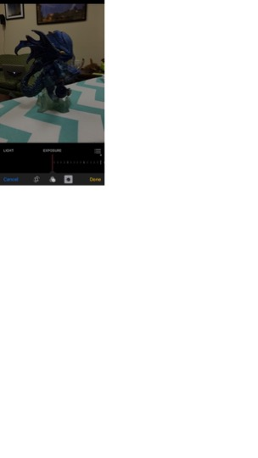
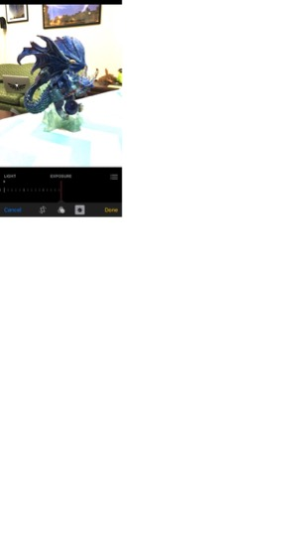
Light

Slide 23
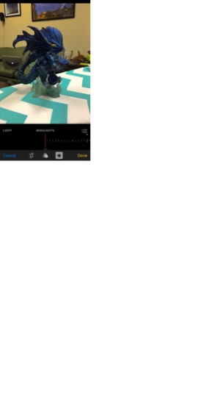
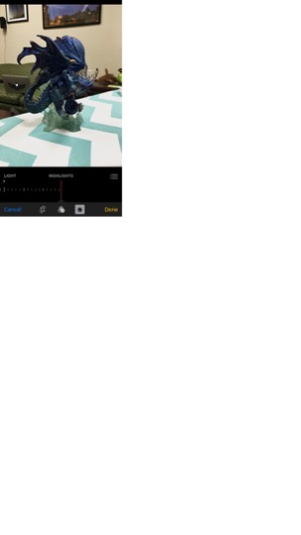
Highlights

Slide 24
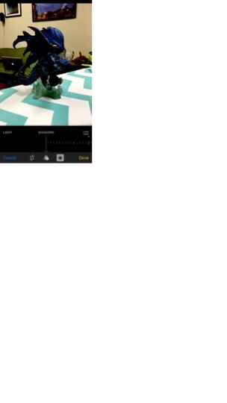
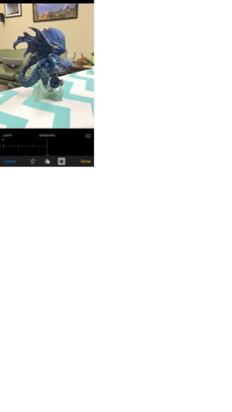
Shadows

Slide 25
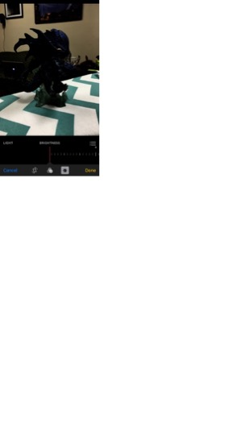
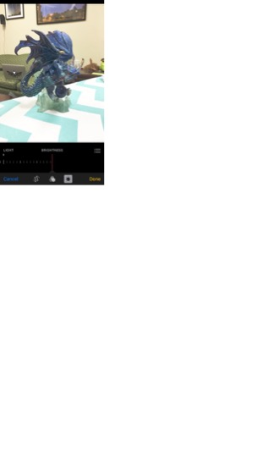
Brightness

Slide 26
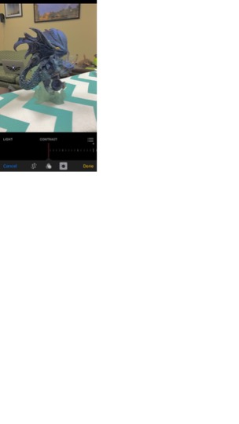
Contrast

Slide 27
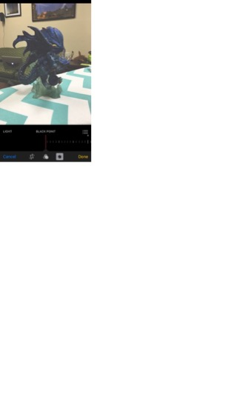
Black Point

Slide 28
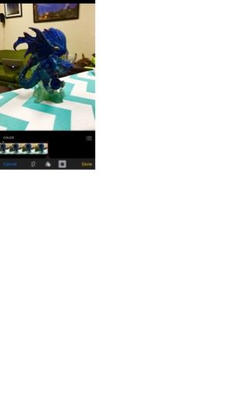
Color

Slide 29
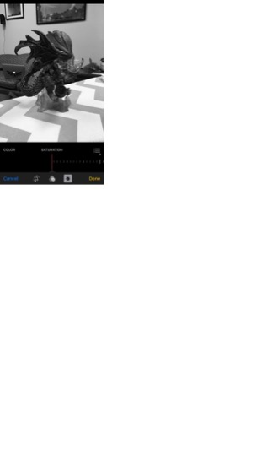
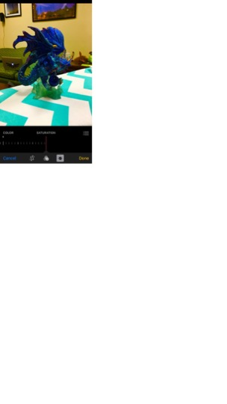
Saturation

Slide 30
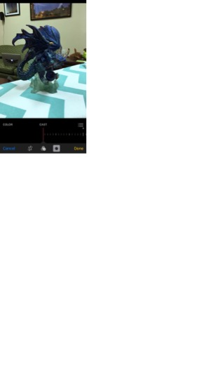
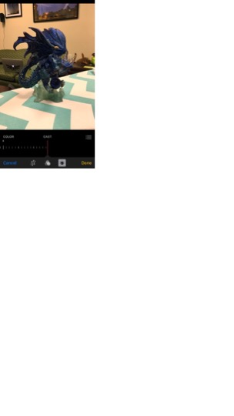
Cast

Slide 31
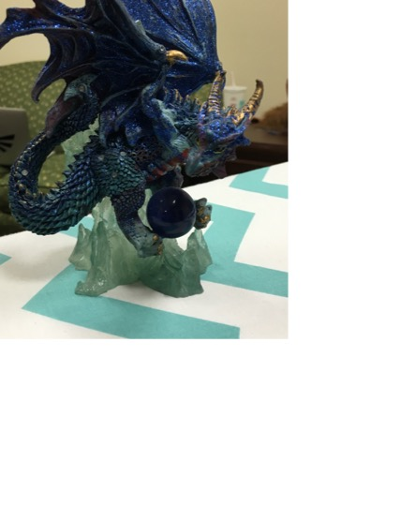
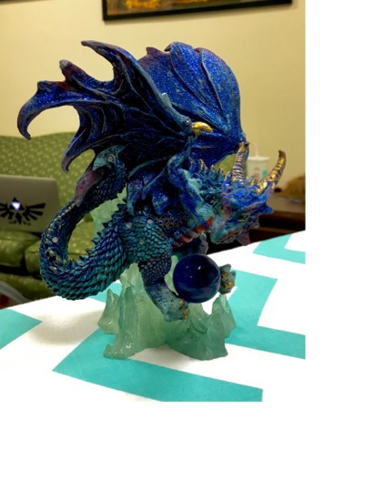
Editing (cont.)
Tips for Editing Images on Your Phone
Before and After
@RicardoTrevinoJ
www.rtjphoto.com
#ACPA17

Slide 32
Editing (cont.)
Tips for Editing Images on Your Phone
Before and After
All people will see images differently
@RicardoTrevinoJ
www.rtjphoto.com
#ACPA17

Slide 33
Last Tips
Final Thoughts
Get out there and PLAY!
Remember, it’s all about perspective.
@RicardoTrevinoJ
www.rtjphoto.com
#ACPA17

Slide 34
TrevinR@MiamiOH.edu www.rtjphoto.com/ACPA17
THANK YOU!! Questions?
@RicardoTrevinoJ
www.rtjphoto.com
#ACPA17

